Slide 1
cs5460/6460: Operating Systems Lecture 11: Context switch
Anton Burtsev
April, 2024

Slide 2
A bit of recap...

Slide 3
When OS context switches between processes?

Slide 4
When OS context switches between processes?
Timer interrupt preempts the current process
A process enters the kernel with a system call and has to wait on some resource
E.g., write to a pipe, but the pipe is full
The process voluntarily yields CPU with the yield() system call

Slide 5
Lets look at timer interrupt

Slide 6
trap()
3351 trap(struct trapframe *tf)
3352 {
...
3363 switch(tf−>trapno){
3364 case T_IRQ0 + IRQ_TIMER:
3365 if(cpu−>id == 0){
3366 acquire(&tickslock);
3367 ticks++;
3368 wakeup(&ticks);
3369 release(&tickslock);
3370 }
3372 break;
...
3423 if(proc && proc−>state == RUNNING
&& tf−>trapno == T_IRQ0+IRQ_TIMER)
3424 yield();

Slide 7
trap()
3351 trap(struct trapframe *tf)
3352 {
...
3363 switch(tf−>trapno){
3364 case T_IRQ0 + IRQ_TIMER:
3365 if(cpu−>id == 0){
3366 acquire(&tickslock);
3367 ticks++;
3368 wakeup(&ticks);
3369 release(&tickslock);
3370 }
3372 break;
...
3423 if(proc && proc−>state == RUNNING
&& tf−>trapno == T_IRQ0+IRQ_TIMER)
3424 yield();

Slide 8
Invoke the scheduler
2777 yield(void)
2778 {
2779 acquire(&ptable.lock);
2780 proc−>state = RUNNABLE;
2781 sched();
2782 release(&ptable.lock);
2783 }

Slide 9
Start the context switch
2758 sched(void)
2759 {
...
2771 swtch(&proc−>context,
cpu−>scheduler);
...
2773 }

Slide 10
But what do you think needs to happen inside switch()?

Slide 11

Process 1
Process 2

Slide 12
What should be in the box?
i.e., what is the state of the process?

Slide 13
2103 struct proc {
2104 uint sz; // Size of process memory (bytes)
2105 pde_t* pgdir; // Page table
2106 char *kstack; // Bottom of kernel stack for this process
2107 enum procstate state; // Process state
2108 volatile int pid; // Process ID
2109 struct proc *parent; // Parent process
2110 struct trapframe *tf; // Trap frame
2111 struct context *context; // swtch() here to run
2112 void *chan; // If non−zero, sleeping on chan
2113 int killed; // If non−zero, have been killed
2114 struct file *ofile[NOFILE]; // Open files
2115 struct inode *cwd; // Current directory
2116 char name[16]; // Process name (debugging)
2117 };

Slide 14
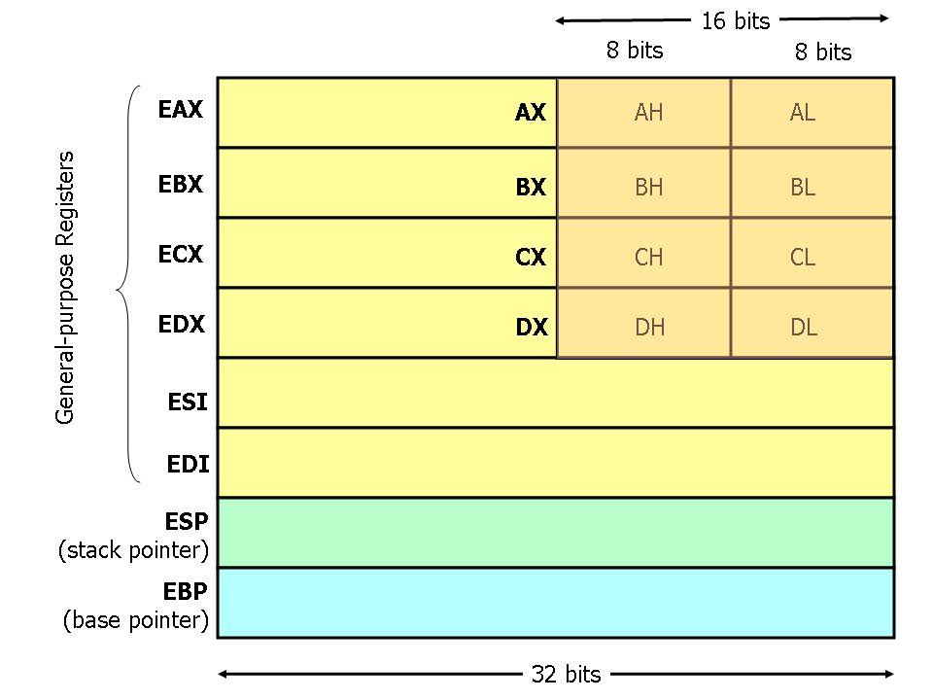
What about general registers?

Slide 15
We need to save callee saved registers
2093 struct context {
2094 uint edi;
2095 uint esi;
2096 uint ebx;
2097 uint ebp;
2098 uint eip;
2099 };
Caller saved registers are already saved by the caller

Slide 16
Process 1
Process 2

Slide 17
Back to the timer interrupt path
(keep track of what happens to the stack, lets see how everything gets packed in the “box”!)

Slide 18
User mode
Two stacks
Kernel and user
Kernel stack is empty

Slide 19
Page table
GDT

Slide 20
Timer interrupt

Slide 21
Timer interrupt

Slide 22
Where does IDT (entry 32) point to?
vector32:
pushl $0 // error code
pushl $32 // vector #
jmp alltraps
Automatically generated
From vectors.pl
vector.S

Slide 23
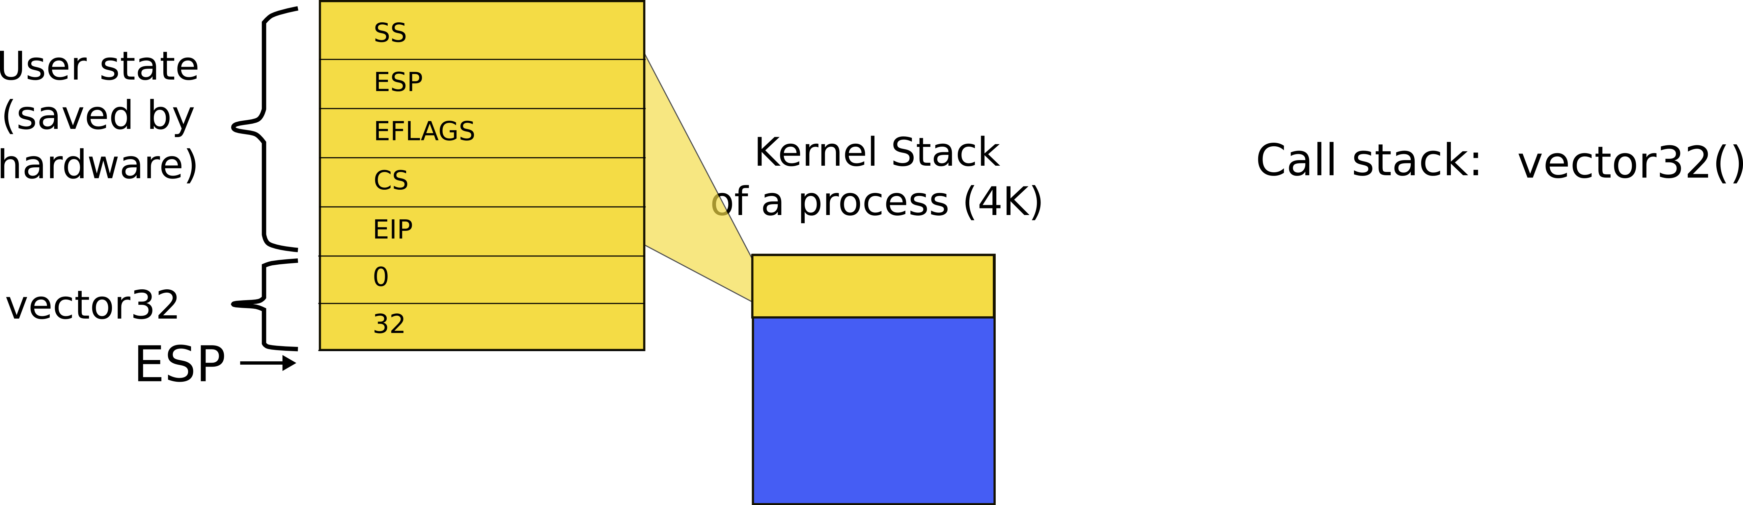
Kernel stack after interrupt

Slide 24
alltraps()
3254 alltraps:
3255 # Build trap frame.
3256 pushl %ds
3257 pushl %es
3258 pushl %fs
3259 pushl %gs
3260 pushal
3261
3262 # Set up data and per−cpu segments.
3263 movw $(SEG_KDATA<<3), %ax
3264 movw %ax, %ds
3265 movw %ax, %es
3266 movw $(SEG_KCPU<<3), %ax
3267 movw %ax, %fs
3268 movw %ax, %gs
3269
3270 # Call trap(tf), where tf=%esp
3271 pushl %esp
3272 call trap

Slide 25
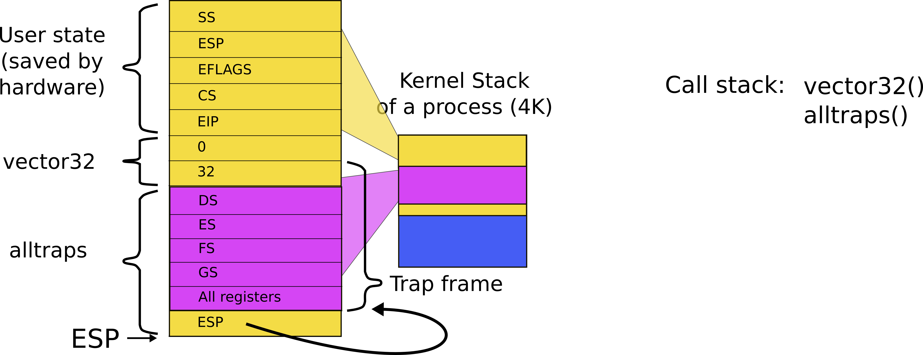
Kernel stack after interrupt

Slide 26
alltraps()
3254 alltraps:
3255 # Build trap frame.
3256 pushl %ds
3257 pushl %es
3258 pushl %fs
3259 pushl %gs
3260 pushal
3261
3262 # Set up data and per−cpu segments.
3263 movw $(SEG_KDATA<<3), %ax
3264 movw %ax, %ds
3265 movw %ax, %es
3266 movw $(SEG_KCPU<<3), %ax
3267 movw %ax, %fs
3268 movw %ax, %gs
3269
3270 # Call trap(tf), where tf=%esp
3271 pushl %esp
3272 call trap

Slide 27
trap()
3351 trap(struct trapframe *tf)
3352 {
...
3363 switch(tf−>trapno){
3364 case T_IRQ0 + IRQ_TIMER:
3365 if(cpu−>id == 0){
3366 acquire(&tickslock);
3367 ticks++;
3368 wakeup(&ticks);
3369 release(&tickslock);
3370 }
3372 break;
...
3423 if(proc && proc−>state == RUNNING
&& tf−>trapno == T_IRQ0+IRQ_TIMER)
3424 yield();

Slide 28
trap()
3351 trap(struct trapframe *tf)
3352 {
...
3363 switch(tf−>trapno){
3364 case T_IRQ0 + IRQ_TIMER:
3365 if(cpu−>id == 0){
3366 acquire(&tickslock);
3367 ticks++;
3368 wakeup(&ticks);
3369 release(&tickslock);
3370 }
3372 break;
...
3423 if(proc && proc−>state == RUNNING
&& tf−>trapno == T_IRQ0+IRQ_TIMER)
3424 yield();

Slide 29
Invoke the scheduler
2777 yield(void)
2778 {
2779 acquire(&ptable.lock);
2780 proc−>state = RUNNABLE;
2781 sched();
2782 release(&ptable.lock);
2783 }

Slide 30
Start the context switch
2758 sched(void)
2759 {
...
2771 swtch(&proc−>context,
cpu−>scheduler);
...
2773 }

Slide 31
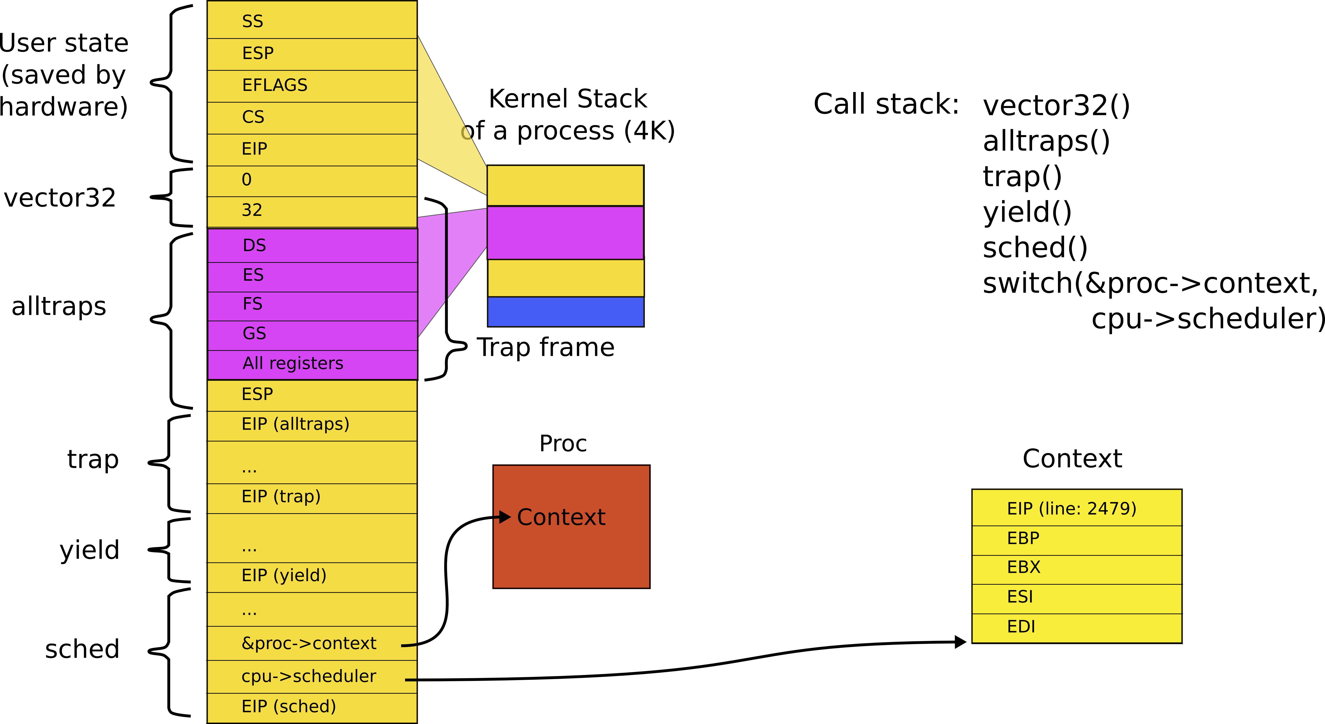
Stack inside swtch() and its two arguments (passed on the stack)

Slide 32
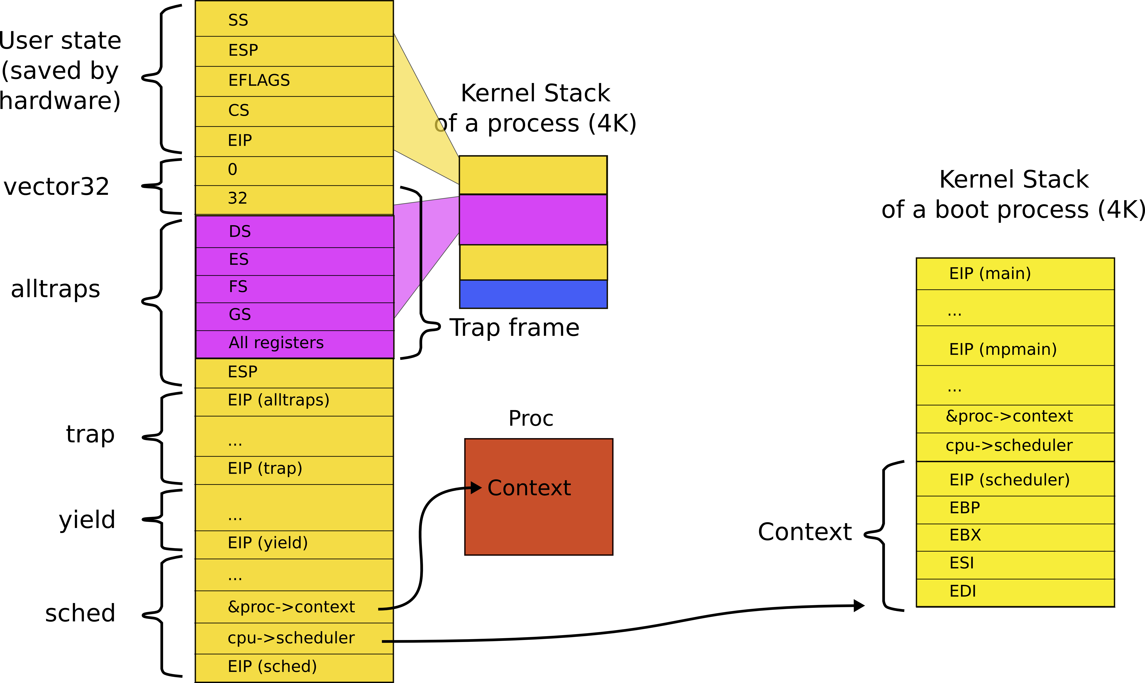
Remember you have two stacks (P1 and P2)
P2
P1

Slide 33
The context switch function should:
pack everything what is left in the box and switch to the new process

Slide 34
What is left unsaved?
Poll:

Slide 35
Callee saved registers

Slide 36
swtch(): save registers on the stack
2958 swtch:
2959 movl 4(%esp), %eax
2960 movl 8(%esp), %edx
2961
2962 # Save old callee−save registers
2963 pushl %ebp
2964 pushl %ebx
2965 pushl %esi
2966 pushl %edi
2967
2968 # Switch stacks
2969 movl %esp, (%eax)
2970 movl %edx, %esp
2971
2972 # Load new callee−save registers
2973 popl %edi
2974 popl %esi
2975 popl %ebx
2976 popl %ebp
2977 ret
2093 struct context {
2094 uint edi;
2095 uint esi;
2096 uint ebx;
2097 uint ebp;
2098 uint eip;
2099 };

Slide 37
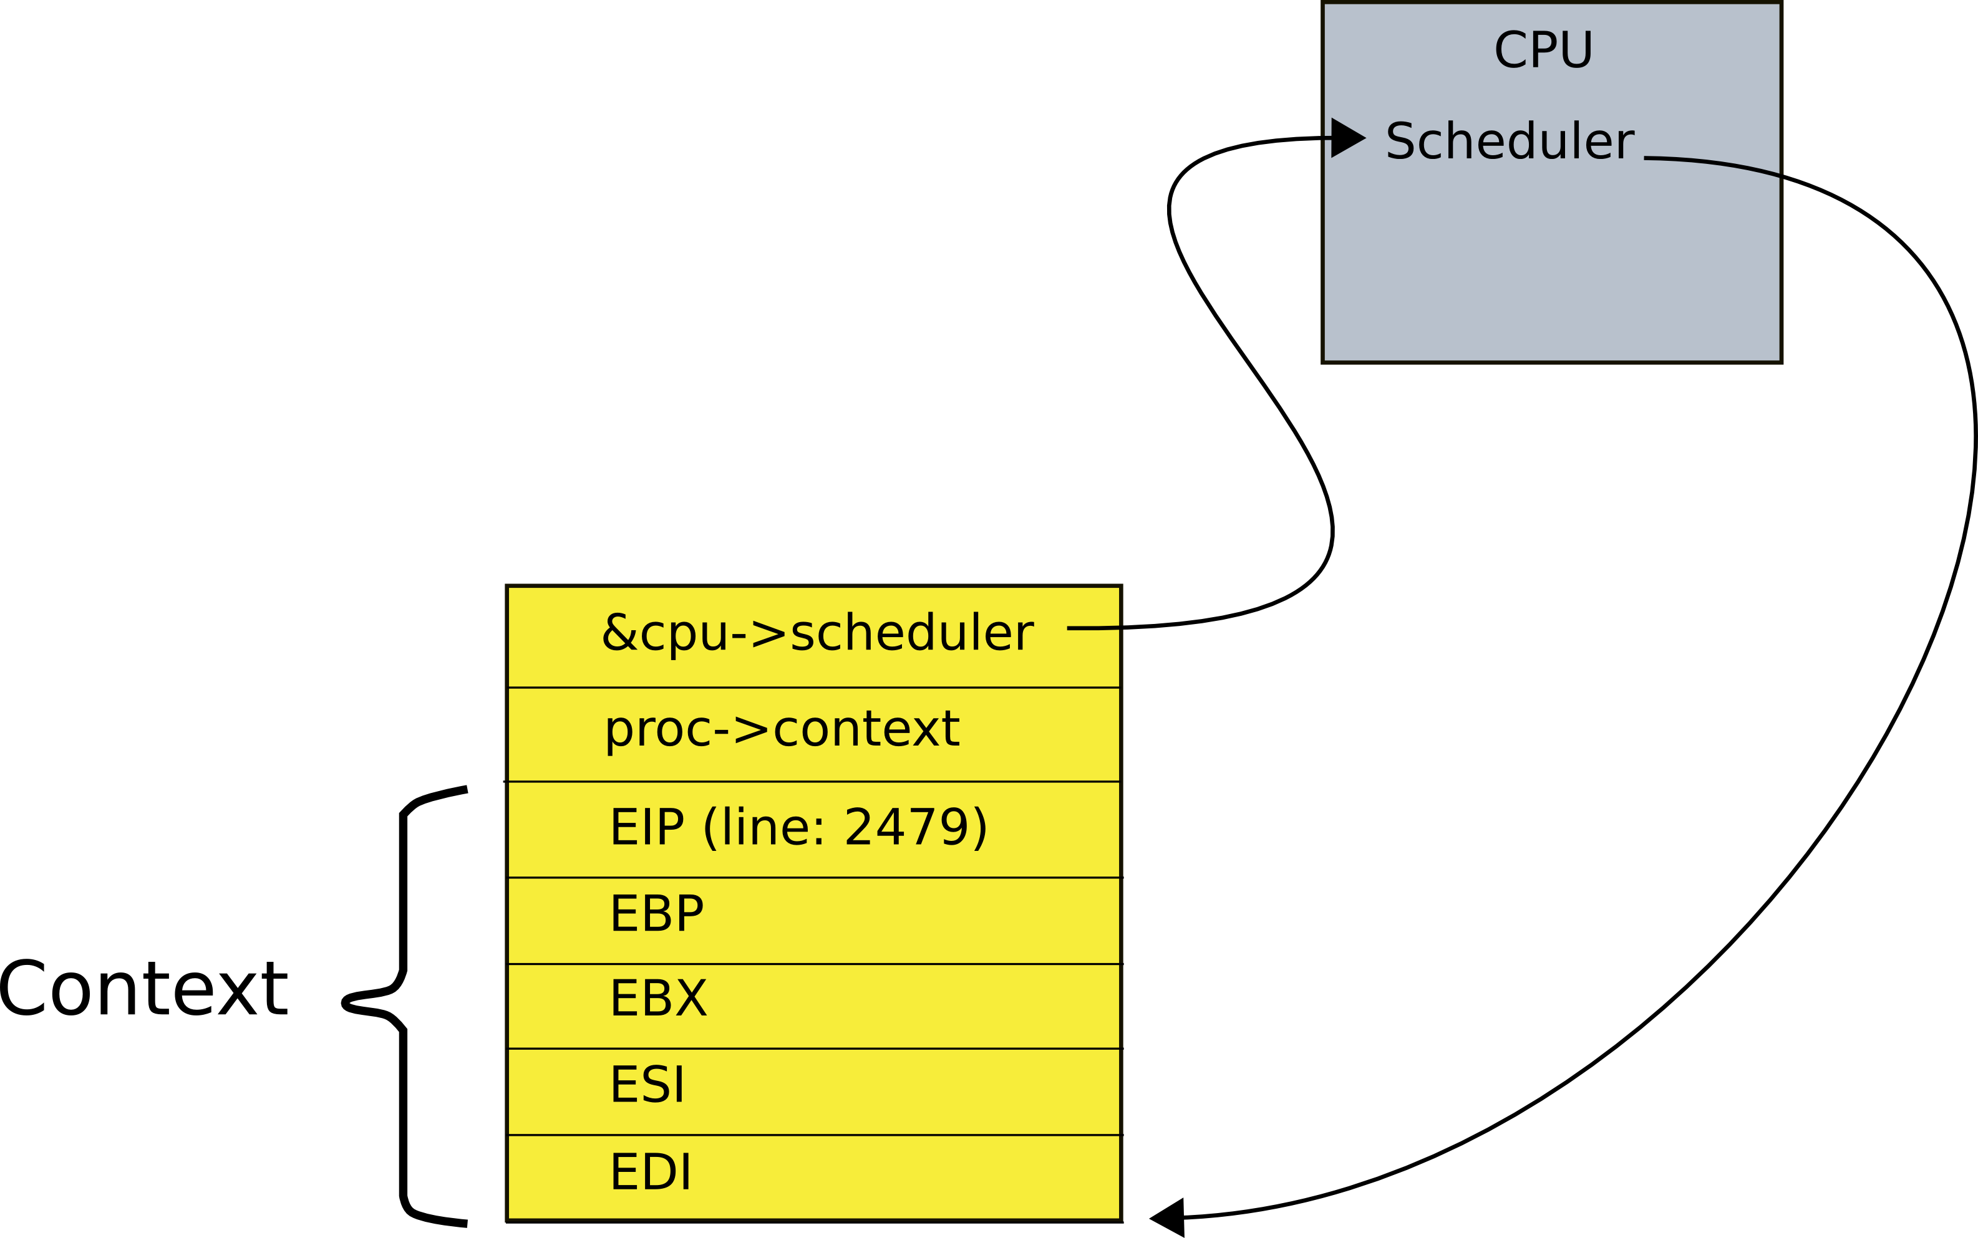
Context data structure is on the top of the stack now
2093 struct context {
2094 uint edi;
2095 uint esi;
2096 uint ebx;
2097 uint ebp;
2098 uint eip;
2099 };

Slide 38
A trick: context is always saved on the top of a stack

Slide 39
And the context switch just saves the old context and loads the new

Slide 40
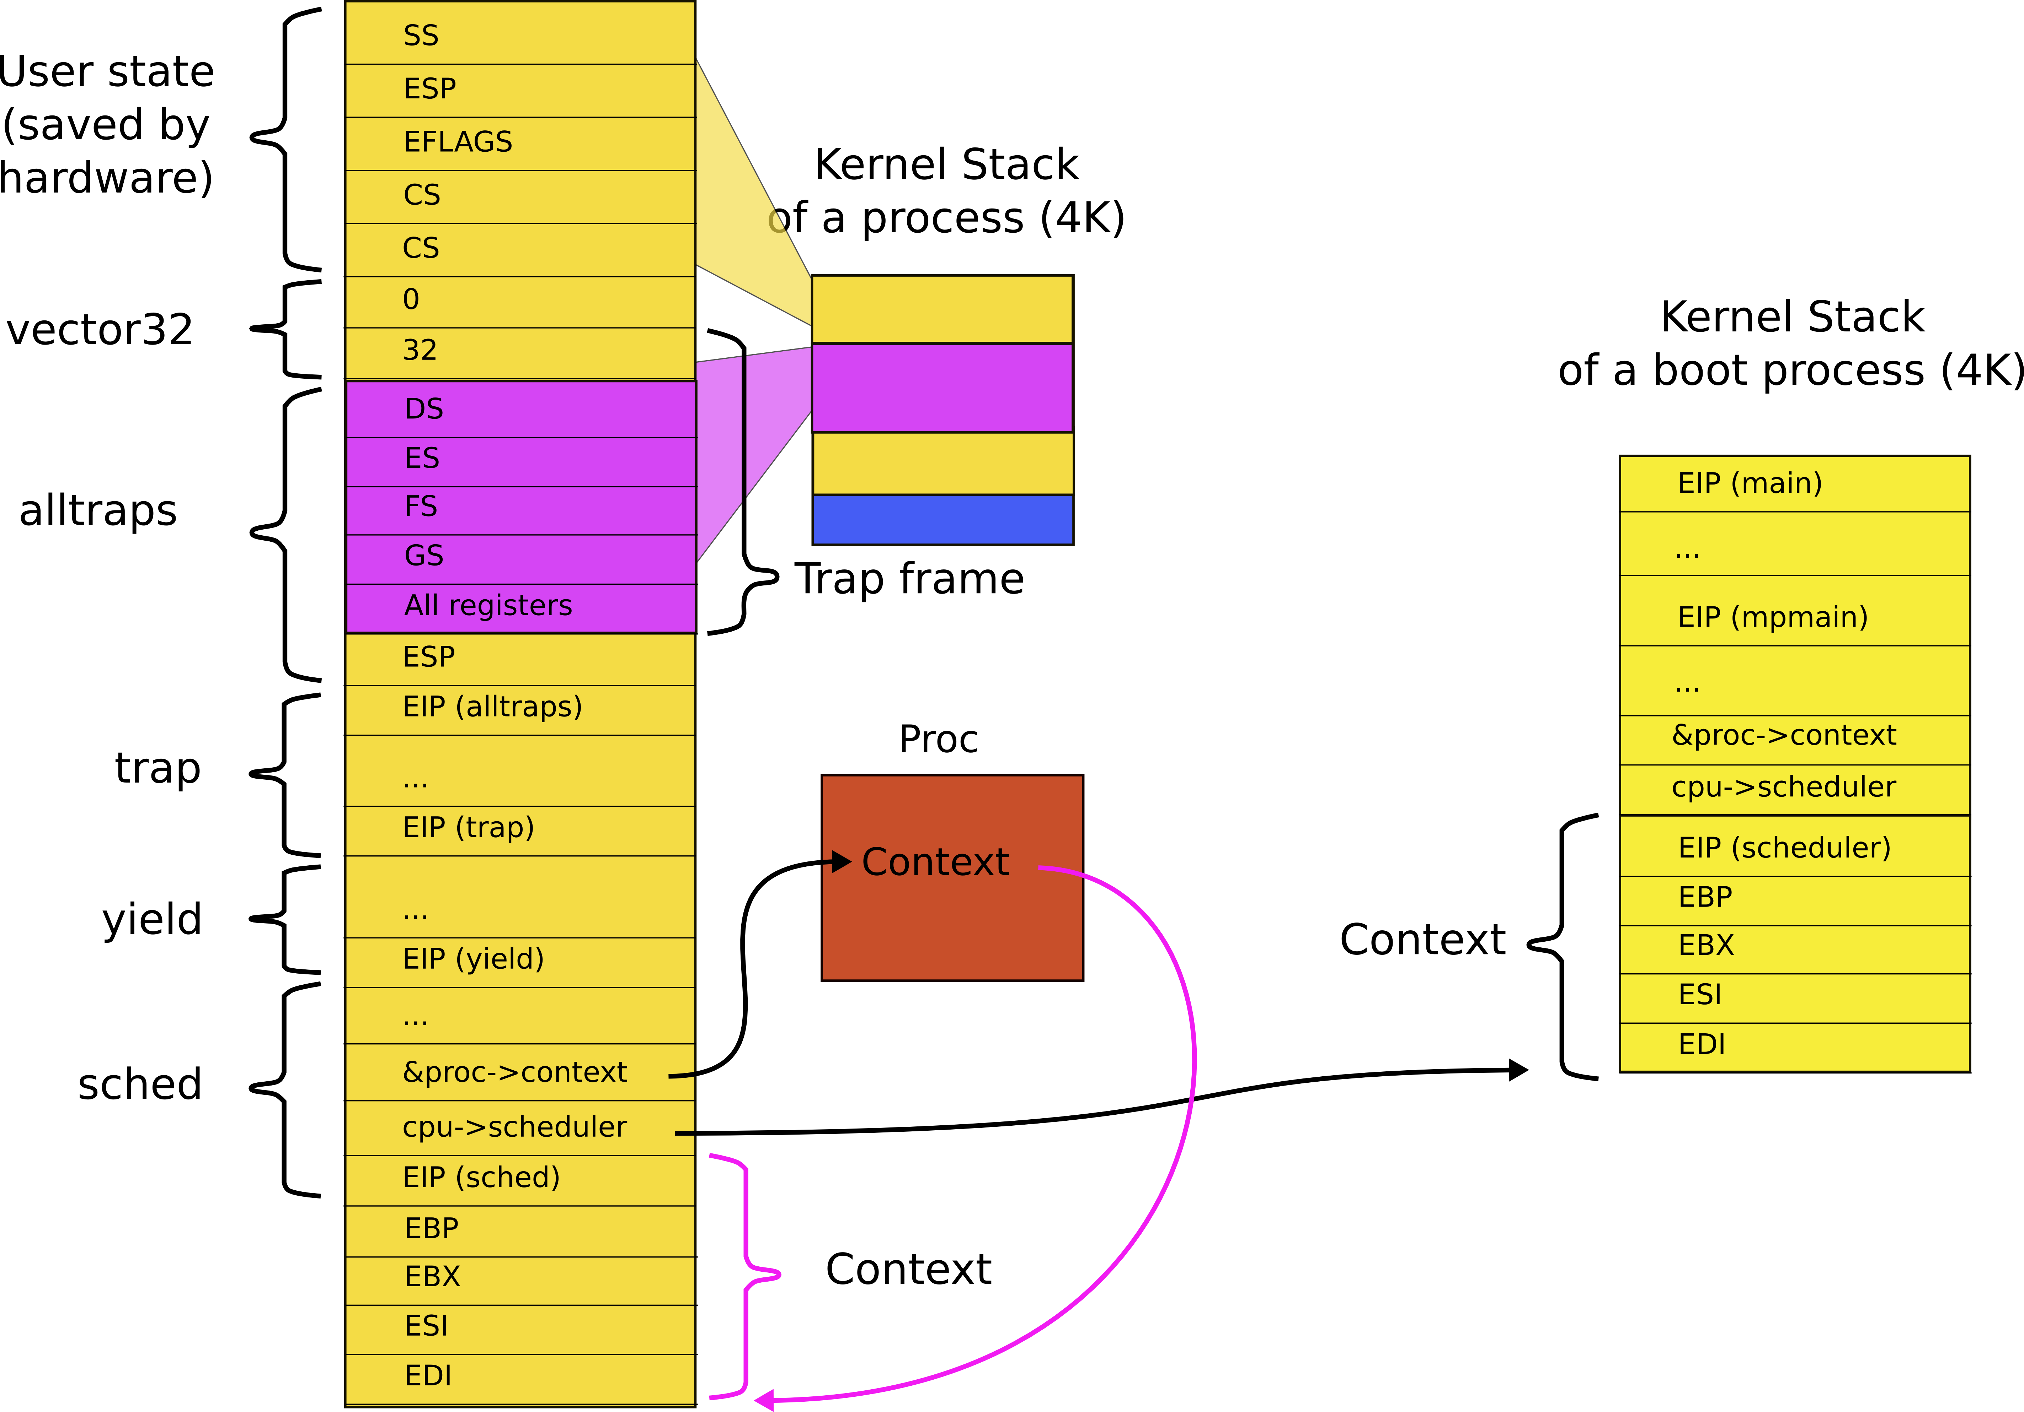
Save the pointer to the stack of the old process (P1) inside the proc data structure (in the context field)
P2
P1

Slide 41
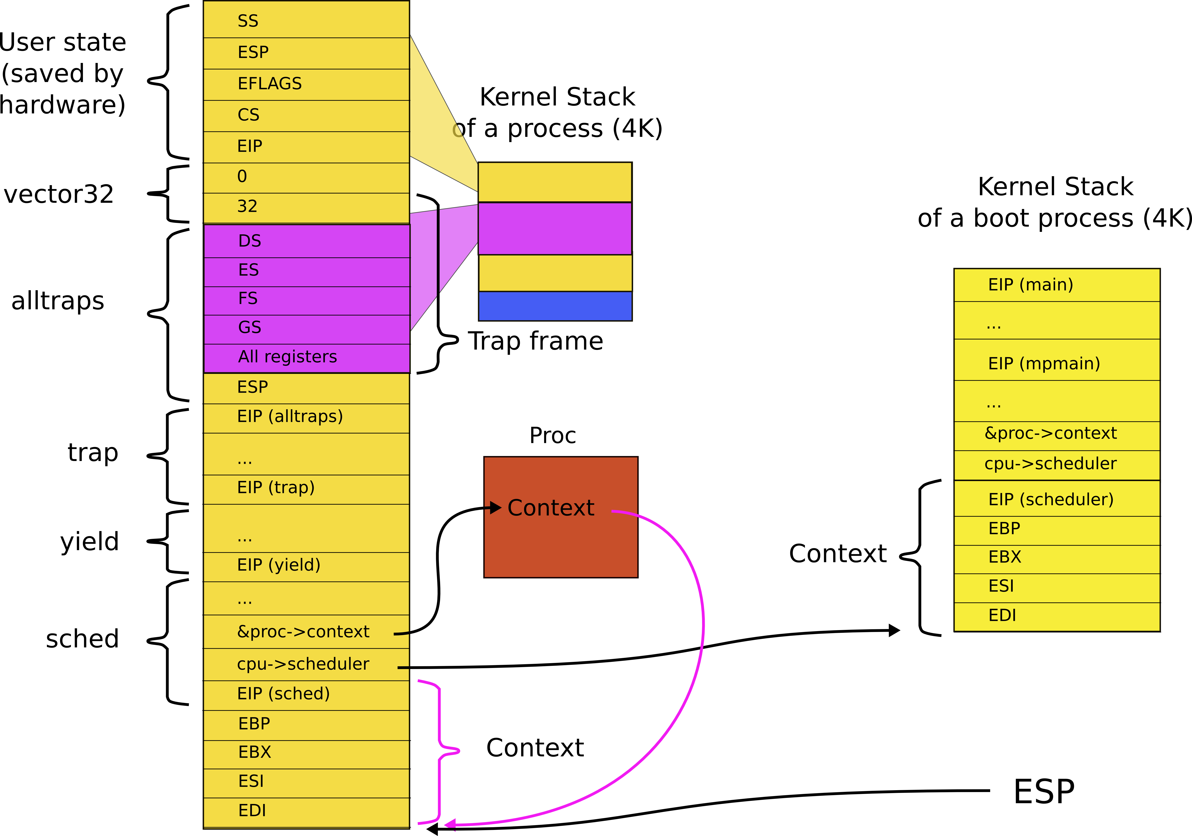
Save context of the old process

Slide 42
Save the current stack
2958 swtch:
2959 movl 4(%esp), %eax // struct context **old
2960 movl 8(%esp), %edx // struct context *new
2961
2962 # Save old callee−save registers
2963 pushl %ebp
2964 pushl %ebx
2965 pushl %esi
2966 pushl %edi
2967
2968 # Switch stacks
2969 movl %esp, (%eax) // save current context (top of current stack)
2970 movl %edx, %esp // set stack to be equal to the new
2971
2972 # Load new callee−save registers
2973 popl %edi
2974 popl %esi
2975 popl %ebx
2976 popl %ebp
2977 ret

Slide 43
Switch to the new stack
2958 swtch:
2959 movl 4(%esp), %eax // struct context **old
2960 movl 8(%esp), %edx // struct context *new
2961
2962 # Save old callee−save registers
2963 pushl %ebp
2964 pushl %ebx
2965 pushl %esi
2966 pushl %edi
2967
2968 # Switch stacks
2969 movl %esp, (%eax) // save current context (top of current stack)
2970 movl %edx, %esp // set stack to be equal to the new
2971
2972 # Load new callee−save registers
2973 popl %edi
2974 popl %esi
2975 popl %ebx
2976 popl %ebp
2977 ret

Slide 44
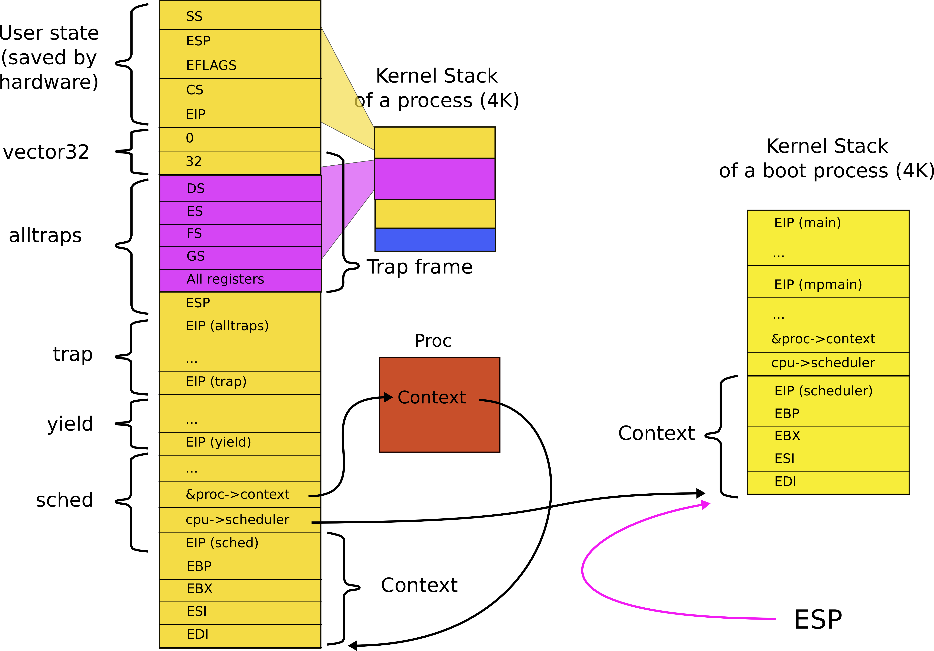
Load stack of the next process

Slide 45
Restore the context of the next process
2958 swtch:
2959 movl 4(%esp), %eax
2960 movl 8(%esp), %edx
2961
2962 # Save old callee−save registers
2963 pushl %ebp
2964 pushl %ebx
2965 pushl %esi
2966 pushl %edi
2967
2968 # Switch stacks
2969 movl %esp, (%eax)
2970 movl %edx, %esp
2971
2972 # Load new callee−save registers
2973 popl %edi
2974 popl %esi
2975 popl %ebx
2976 popl %ebp
2977 ret

Slide 46
But how do we switch the process?
2958 swtch:
2959 movl 4(%esp), %eax
2960 movl 8(%esp), %edx
2961
2962 # Save old callee−save registers
2963 pushl %ebp
2964 pushl %ebx
2965 pushl %esi
2966 pushl %edi
2967
2968 # Switch stacks
2969 movl %esp, (%eax)
2970 movl %edx, %esp
2971
2972 # Load new callee−save registers
2973 popl %edi
2974 popl %esi
2975 popl %ebx
2976 popl %ebp
2977 ret
I.e., switch the instruction pointer?

Slide 47
Remember: the context is at the top of some stack

Slide 48
If we load the new context into ESP we can return on that new stack

Slide 49
But how do we switch the process?
2958 swtch:
2959 movl 4(%esp), %eax
2960 movl 8(%esp), %edx
2961
2962 # Save old callee−save registers
2963 pushl %ebp
2964 pushl %ebx
2965 pushl %esi
2966 pushl %edi
2967
2968 # Switch stacks
2969 movl %esp, (%eax)
2970 movl %edx, %esp
2971
2972 # Load new callee−save registers
2973 popl %edi
2974 popl %esi
2975 popl %ebx
2976 popl %ebp
2977 ret
I.e., switch the instruction pointer?

Slide 50
Where does this swtch() return?

Slide 51
Context is always top of some stack...ok, but how?
How does initialization of each CPU end?

Slide 52
1317 main(void)
1318 {
1319 kinit1(end, P2V(4*1024*1024)); // phys page allocator
1320 kvmalloc(); // kernel page table
1321 mpinit(); // detect other processors
...
1323 seginit(); // segment descriptors
...
1330 tvinit(); // trap vectors
...
1338 userinit(); // first user process
1339 mpmain(); // finish this processor’s setup
1340 }
main()

Slide 53
1260 // Common CPU setup code.
1261 static void
1262 mpmain(void)
1263 {
1264 cprintf("cpu%d: starting\n", cpu−>id);
1265 idtinit(); // load idt register
1266 xchg(&cpu−>started, 1);
1267 scheduler(); // start running processes
1268 }
main()
mpmain()

Slide 54
We ended boot by starting the scheduler

Slide 55
Scheduler()
2458 scheduler(void)
2459 {
2462 for(;;){
2468 for(p = ptable.proc; p < &ptable.proc[NPROC]; p++){
2469 if(p−>state != RUNNABLE)
2470 continue;
2475 proc = p;
2476 switchuvm(p);
2477 p−>state = RUNNING;
2478 swtch(&cpu−>scheduler, proc−>context);
2479 switchkvm();
2483 proc = 0;
2484 }
2487 }
2488 }
Chooses next process to run
Switches to it
From the current context

Slide 56
2301 struct cpu {
2302 uchar apicid; // Local APIC
2303 struct context *scheduler; // swtch() here to enter scheduler
2304 struct taskstate ts; // TSS
2305 struct segdesc gdt[NSEGS]; // x86 global descriptor table
2306 volatile uint started; // Has the CPU started?
2307 int ncli; // Depth of pushcli nesting.
2308 int intena; // Were interrupts enabled ...
2309 struct proc *proc; // The process running on this cpu
2310 };
2311
2312 extern struct cpu cpus[NCPU];
2313 extern int ncpu;

Slide 57
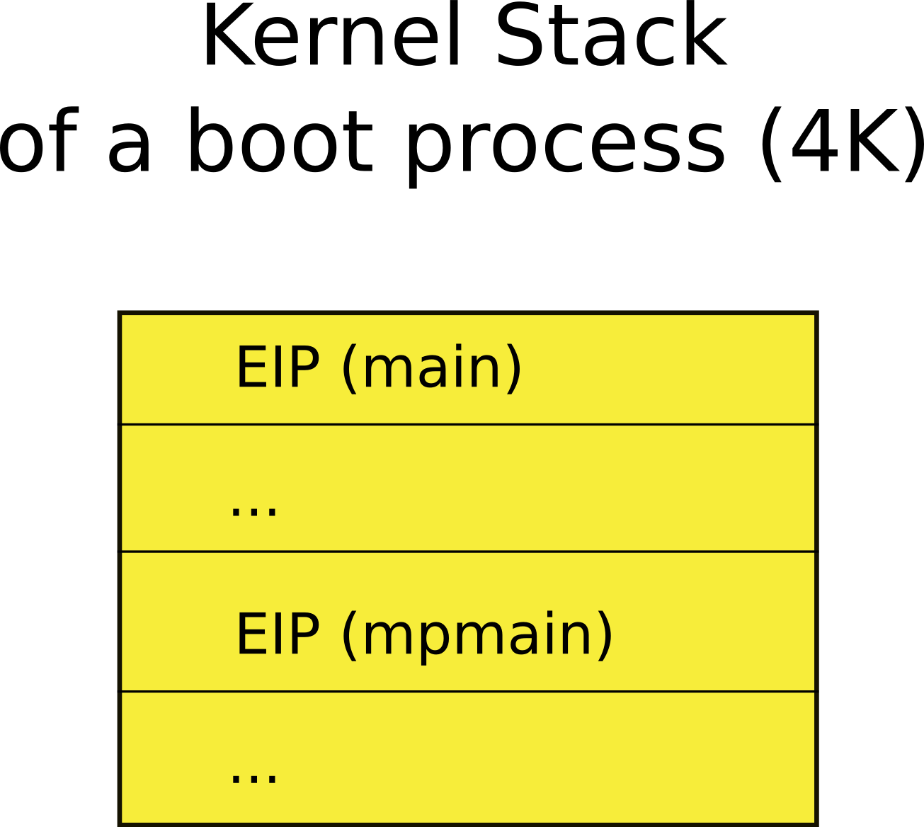
This is how the stack looked after boot finished, i.e., inside mpmain()

Slide 58
When the scheduler context switched the first time
2478 swtch(&cpu−>scheduler,
proc−>context);
We saved the current context of the scheduler into:
&cpu−>scheduler
And restored the context of the first process
proc−>context

Slide 59
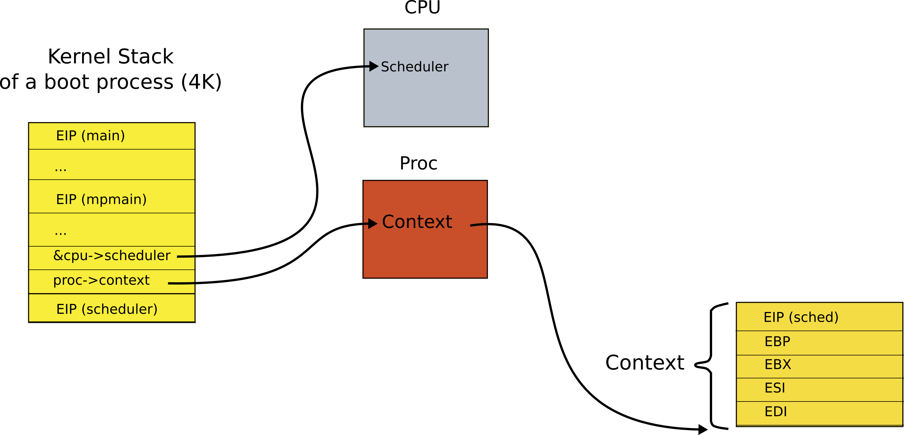
This is how stack looked like when scheduler() invoked swtch() for the first time
Which process is represented by this context?

Slide 60
This is how stack looked like when scheduler() invoked swtch() for the first time
Poll:
Which process is represented by this context?

Slide 61
2456 allocproc(void)
2457 {
...
2477 // Leave room for trap frame.
2478 sp −= sizeof *p−>tf;
2479 p−>tf = (struct trapframe*)sp;
2480
2481 // Set up new context to start executing at forkret,
2482 // which returns to trapret.
2483 sp −= 4;
2484 *(uint*)sp = (uint)trapret;
2485
2486 sp −= sizeof *p−>context;
2487 p−>context = (struct context*)sp;
2488 memset(p−>context, 0, sizeof *p−>context);
2489 p−>context−>eip = (uint)forkret;
...
2492 }
Context is configured as top of the stack when new process is created inside allocproc() function
Remember fork()?

Slide 62
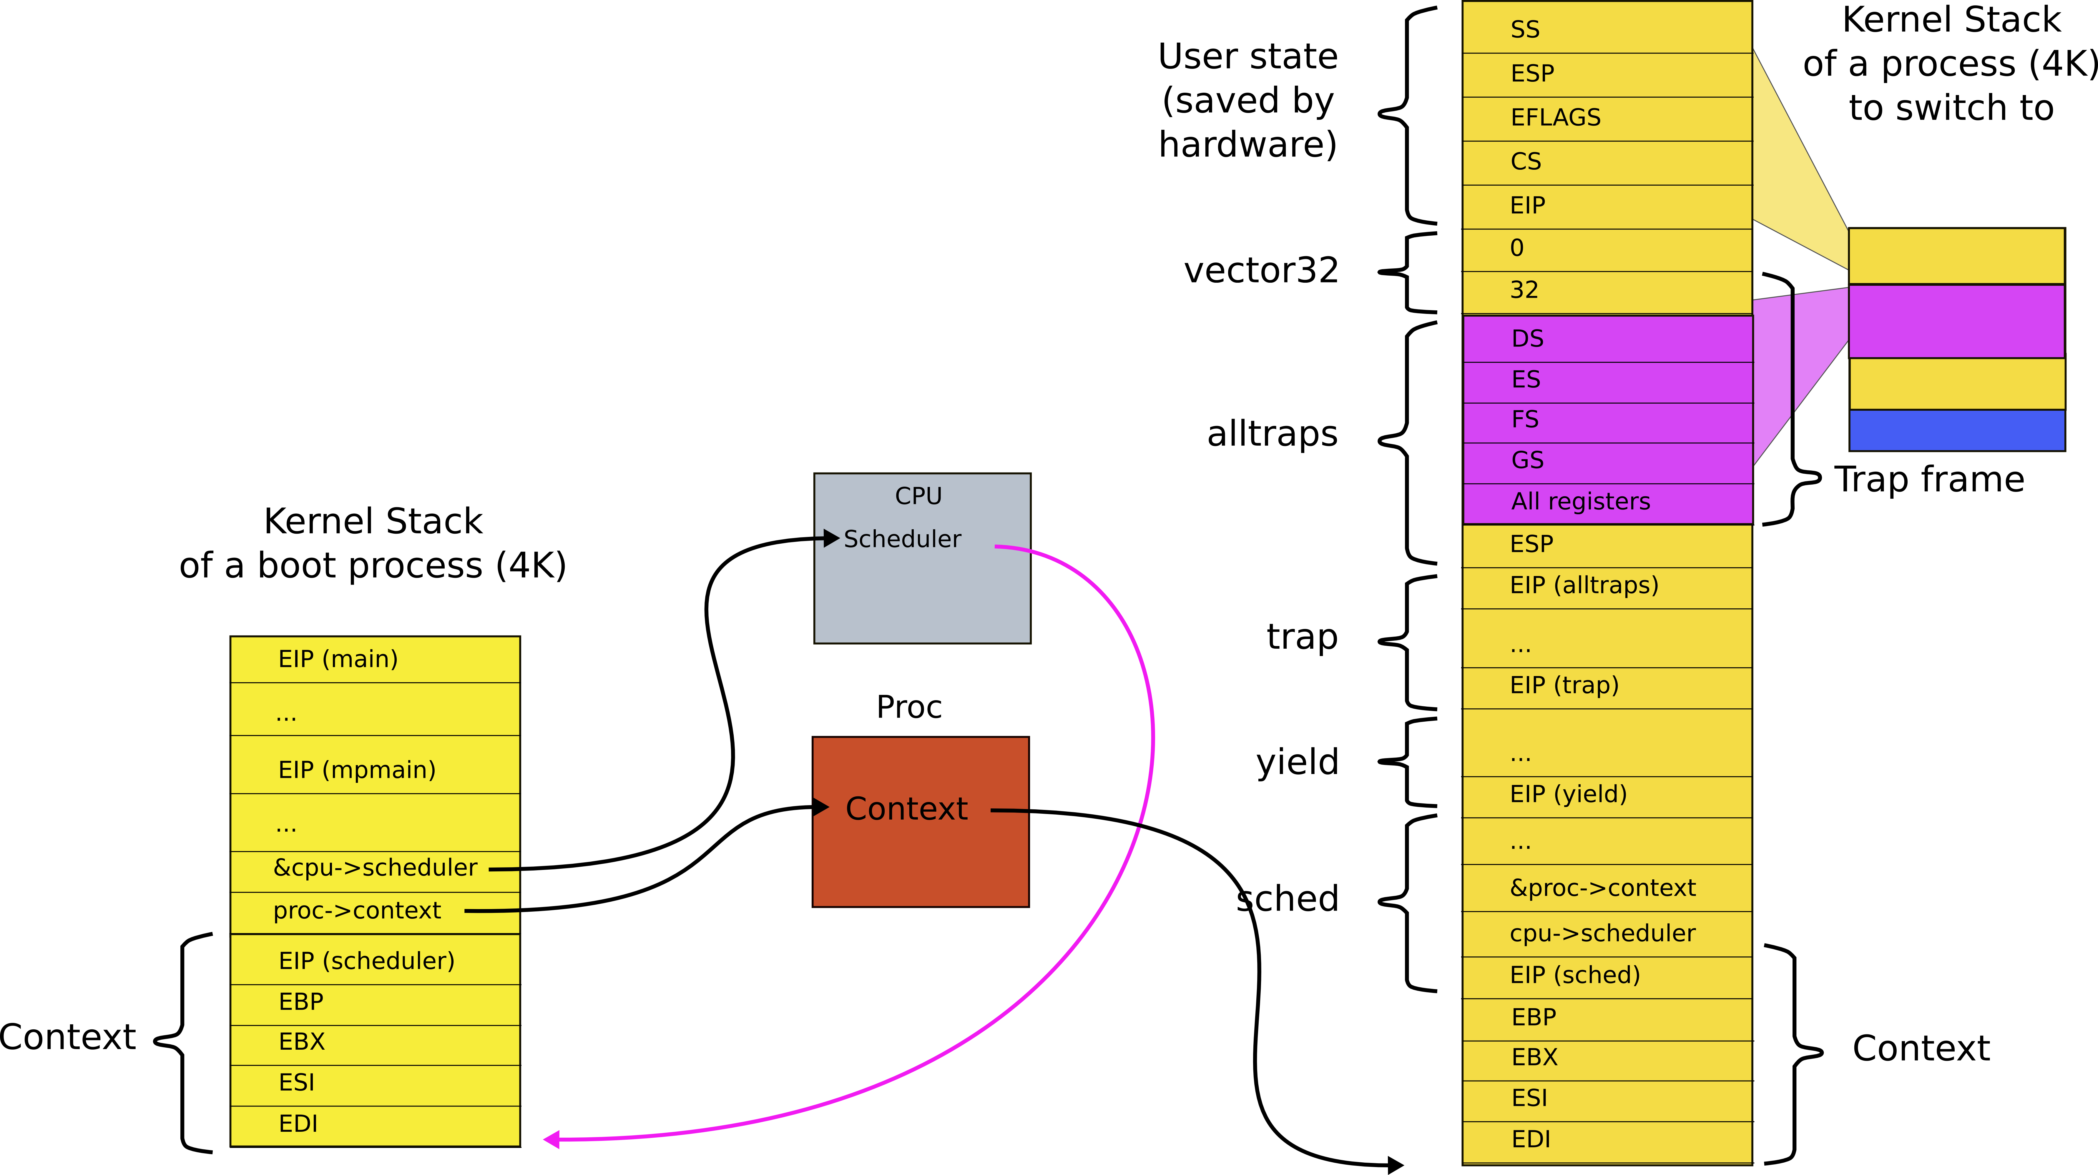
At the end of boot we switched to the first process
Saved the context of the scheduler
Loaded the context of this first process

Slide 63
swtch()
2958 swtch:
2959 movl 4(%esp), %eax // struct context **old
2960 movl 8(%esp), %edx // struct context *new
2961
2962 # Save old callee−save registers
2963 pushl %ebp
2964 pushl %ebx
2965 pushl %esi
2966 pushl %edi
2967
2968 # Switch stacks
2969 movl %esp, (%eax) // load current context (top of current stack) into
// the memory location pointed by *old
2970 movl %edx, %esp // set stack to be equal to *new (the top of the new context)
2971
2972 # Load new callee−save registers
2973 popl %edi
2974 popl %esi
2975 popl %ebx
2976 popl %ebp
2977 ret

Slide 64
The context is the top of some stack
Initially it was the stack of mpenter()
On which scheduler started
Then first process...
Then scheduler again
And the next process...

Slide 65
Back to the context switch
(we now know we return into the scheduler)

Slide 66
Where does this swtch() return?
Scheduler!
Remember:
We started with timer interrupt
Entered the kernel
Entered schedule()
Entered switch
And are currently on our way from the process into the scheduler

Slide 67
What does scheduler do?
2458 scheduler(void)
2459 {
2462 for(;;){
2468 for(p = ptable.proc; p < &ptable.proc[NPROC]; p++){
2469 if(p−>state != RUNNABLE)
2470 continue;
2475 proc = p;
2476 switchuvm(p);
2477 p−>state = RUNNING;
2478 swtch(&cpu−>scheduler, proc−>context);
2479 switchkvm();
2483 proc = 0;
2484 }
2487 }
2488 }
Chooses next process to run
Switches to it

Slide 68
What does stack look like when scheduler() invokes swtch()?
Stack (context) of the scheduler

Slide 69
What does stack look like when scheduler() invokes swtch()?
Where does the proc->context point?

Slide 70
What does stack look like when scheduler() invokes swtch()?
Where does the proc->context point?
Right the context (stack) of the next process to run

Slide 71
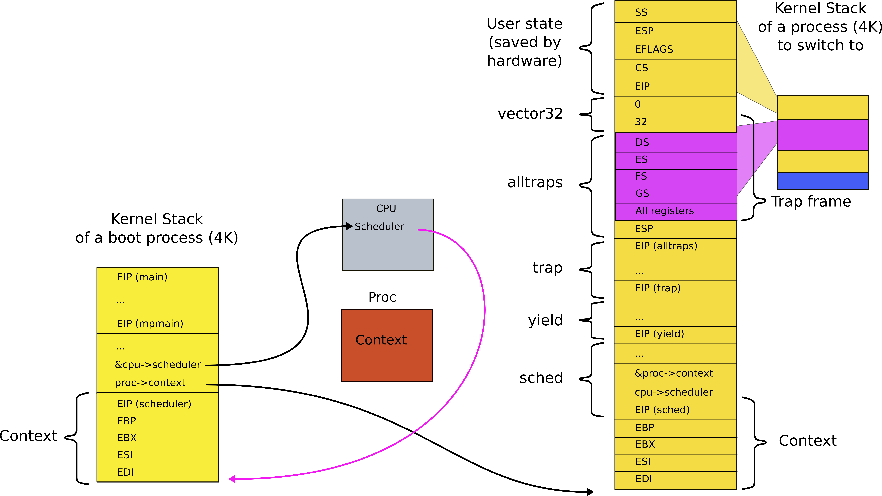
We save the context of the scheduler
Restore the context of the next proces

Slide 72
Remember, from inside the scheduler we invoked swtch() as
2478 swtch(&cpu−>scheduler,
proc−>context);
Hence, we save context of the scheduler into
&cpu−>scheduler
And restore
proc−>context

Slide 73
Stacks and contexts inside the swtch()

Slide 74
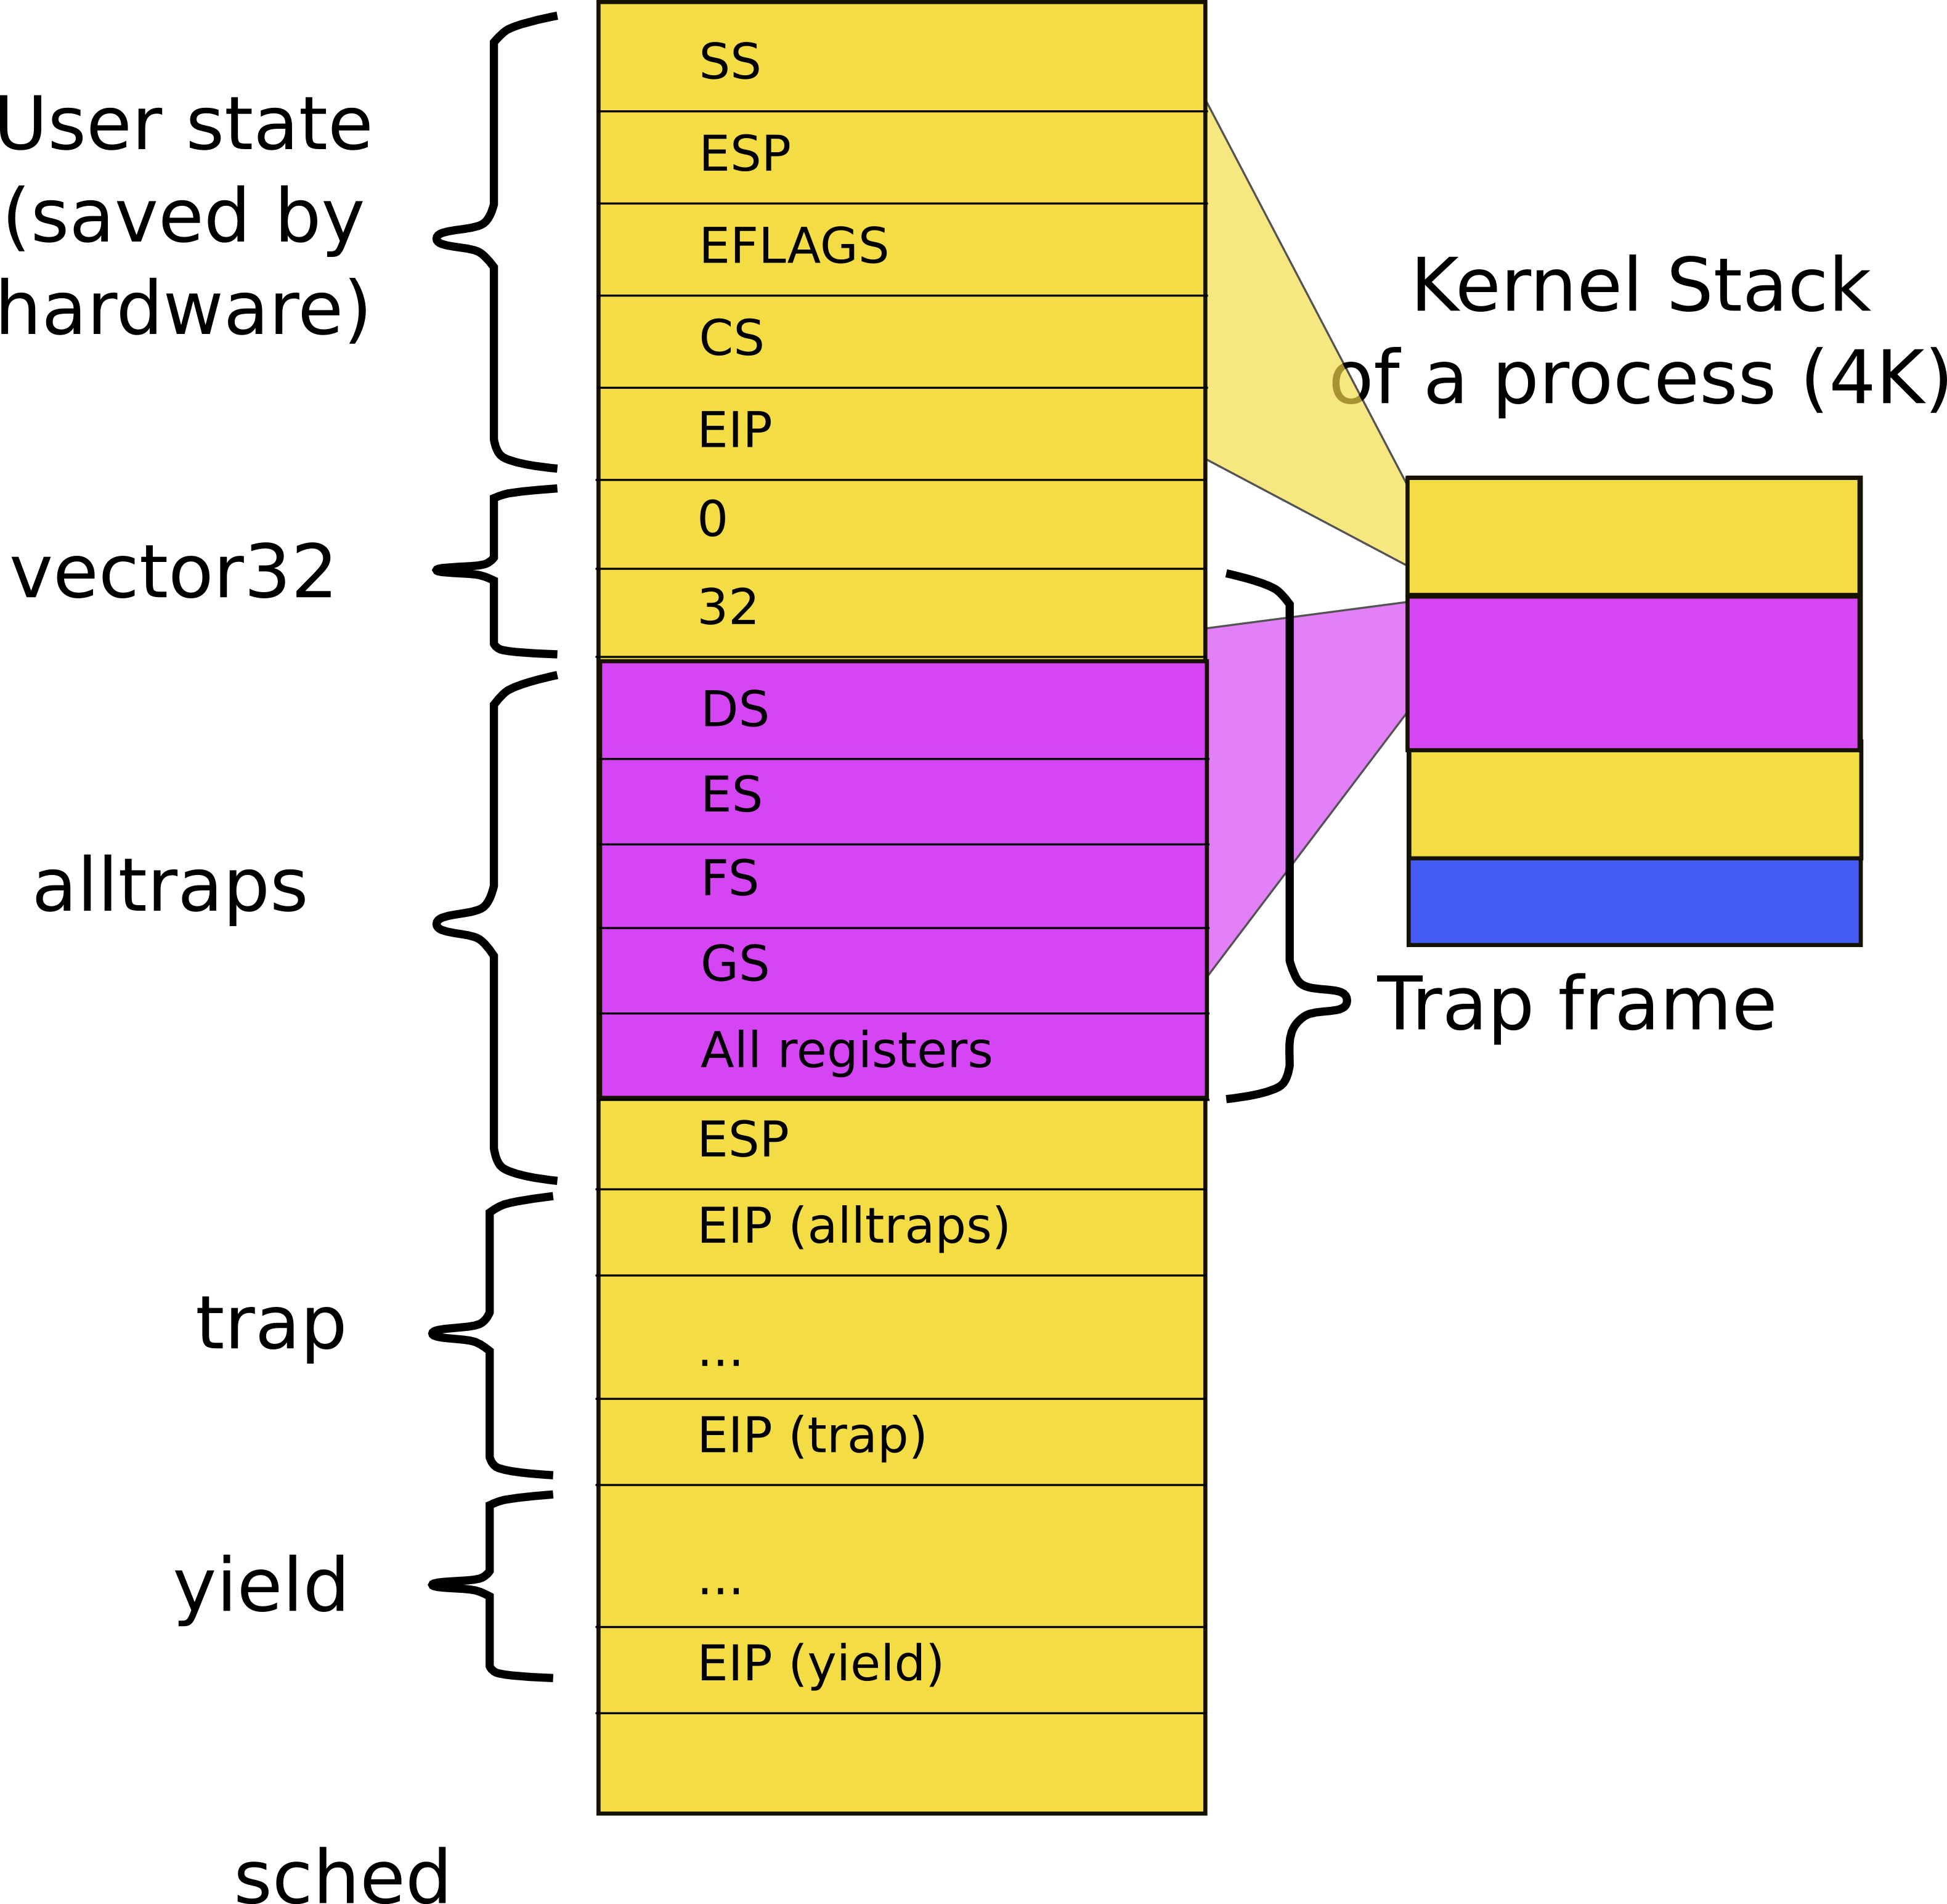
Exiting back to user-level
Stack of the process after context switch, i.e., inside sched()
Return as usual all the way to alltrap()

Slide 75
alltraps(): exit into user-level
3004 alltraps:
...
3020 # Call trap(tf), where tf=%esp
3021 pushl %esp
3022 call trap
3023 addl $4, %esp
3024
3025 # Return falls through to trapret...
3026 .globl trapret
3027 trapret:
3028 popal
3029 popl %gs
3030 popl %fs
3031 popl %es
3032 popl %ds
3033 addl $0x8, %esp # trapno and errcode
3034 iret

Slide 76
We're back to where we started, but in a new process

Slide 77
Summary
We switch between processes now

Slide 78
Thank you

